Slide 1
SystemVerilog HDL Workshop #3
044252 - Digital Systems and Computer Structure

Slide 2
Topics Covered Last Time
Hardware Description Languages
SystemVerilog Building Blocks:
Values / Number representation
Bitwise operators
Module implementation
Module instantiation
Concurrent assignments
Procedural blocks
Parameters
Parallelism in HDL
Test benches and simulation

Slide 3
Topics Covered Last Time
Hardware Description Languages
SystemVerilog Building Blocks:
Values / Number representation
Bitwise operators
Module implementation
Module instantiation
Concurrent assignments
Procedural blocks
Parameters
Parallelism in HDL
Test benches and simulation

Slide 4
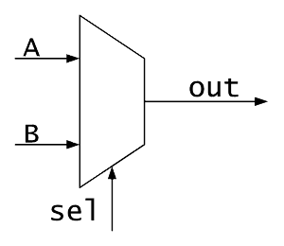
Module Instantiation - Recap
2-bit wide mux from two 1-bit muxes
A[1:0]
A]0[
B]0[
O[1:0]
module mux2to1_2 (
output logic [1:0] O,
input logic [1:0] A,
input logic [1:0] B,
input logic sel
);
mux2to1 mux0 (.out(O[0]), .sel(sel), .A(A[0]), .B(B[0]));
mux2to1 mux1 (.out(O[1]), .sel(sel), .A(A[1]), .B(B[1]));
endmodule
B[1:0]
A]1[
B]1[
sel

Slide 5
Concurrent Assignments - Recap
Connect a wire to a combinational logic or another wire
When the right-hand-side of an assignment changes, it immediately flows through to the left-hand-side wire
Syntax:
logic signal;
assign signal = 1'b0;
logic signal1;
logic signal2;
assign signal2 = signal1;

Slide 6
Procedural Blocks - Recap
Sequential: all statements inside the block are executed sequentially
One line after the other
Two procedural constructs:
initial:
always_comb:
initial begin
<statement1>;
# time_to_wait
<statement2>;
# time_to_wait
...
end
always_comb begin
<statement1>;
<statement2>;
...
end

Slide 7
Agenda
More operators
Conditional statements
Synchronous logic and assignments
Test benches for synchronous logic

Slide 8
Agenda
More operators
Conditional statements
Synchronous logic and assignments
Test benches for synchronous logic

Slide 9
Relational Operators
Meaning | Operator
Less than | <
Less than or equal to | <=
Greater than | >
Greater than or equal to | >=
Equal to | ==
Not equal to | !=
All of these return a 1-bit logical value (true/false or ‘x’)

Slide 10
Logical Operators
Used for conditions
Operands evaluated to 1-bit value: 0 (false), 1 (true) or x
Result is 1-bit value: 0 (false), 1 (true) or x
Meaning | Operator
Logical AND | &&
Logical OR | ||
Logical NOT | !

Slide 11
Logical Operators
logic A, B, C;
assign A = 1'b1;
assign B = 1'b0;
assign C = 1'bx;
Examples:
false | true && false → | A && B →
true | true || true → | A || !B →
x | x || false → | C || B →
false | x && false → | C && B →

Slide 12
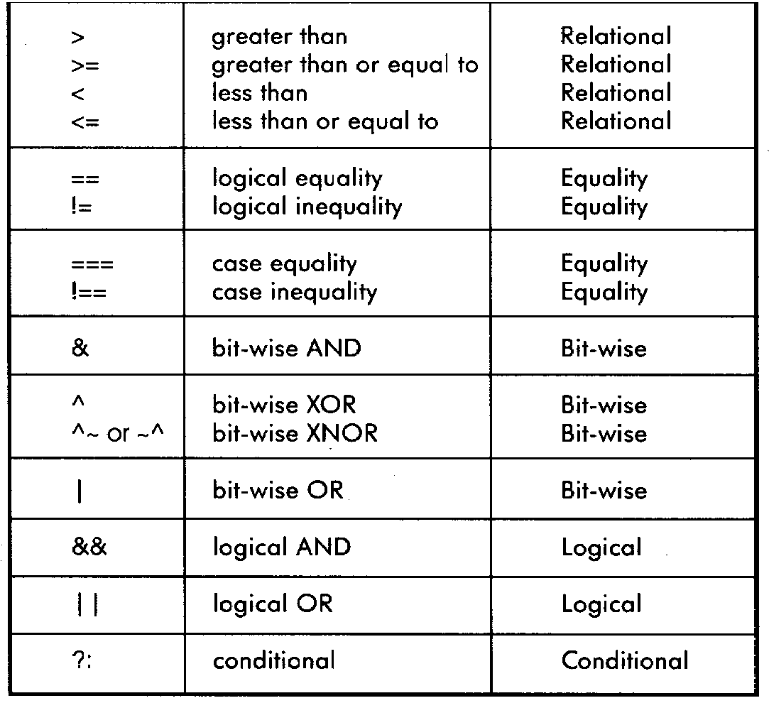
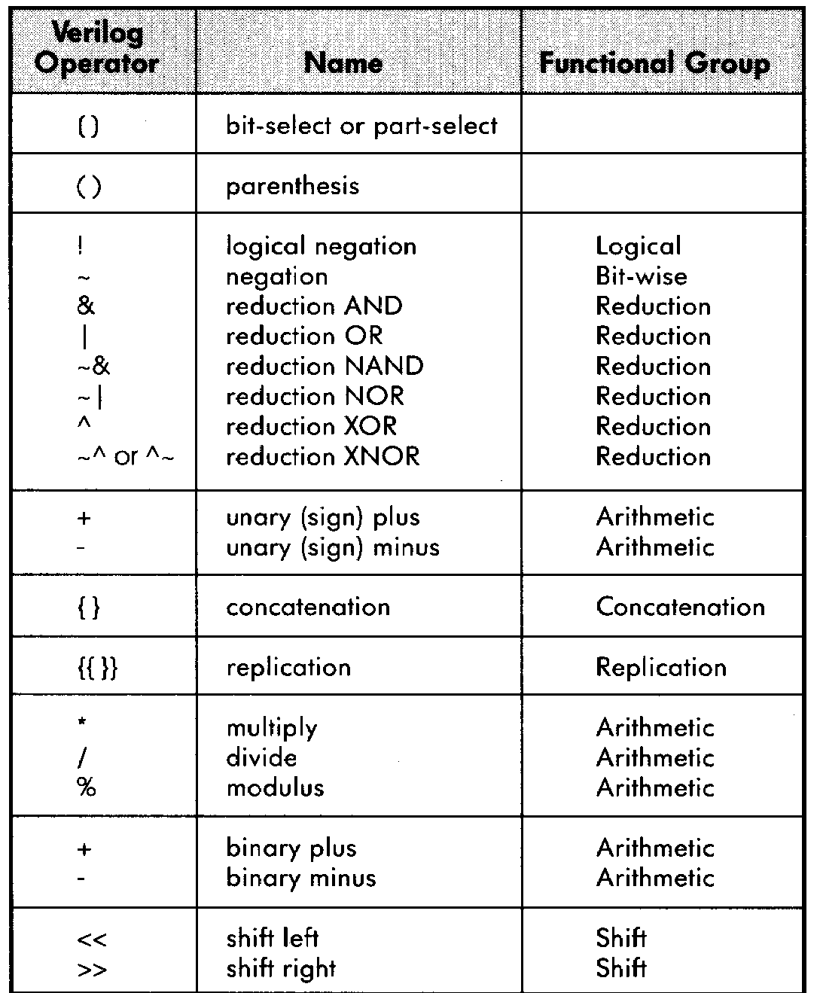
SystemVerilog Operator Precedence

Slide 13
Agenda
More operators
Conditional statements
Synchronous logic and assignments
Test benches for synchronous logic

Slide 14
Conditional Statements: The if Statement
Used in procedural blocks
Syntax:
if (condition1) begin
<statement1>;
end
else if (condition2) begin
<statement2>;
end
else begin
<statement3>;
<statement4>;
end

Slide 15
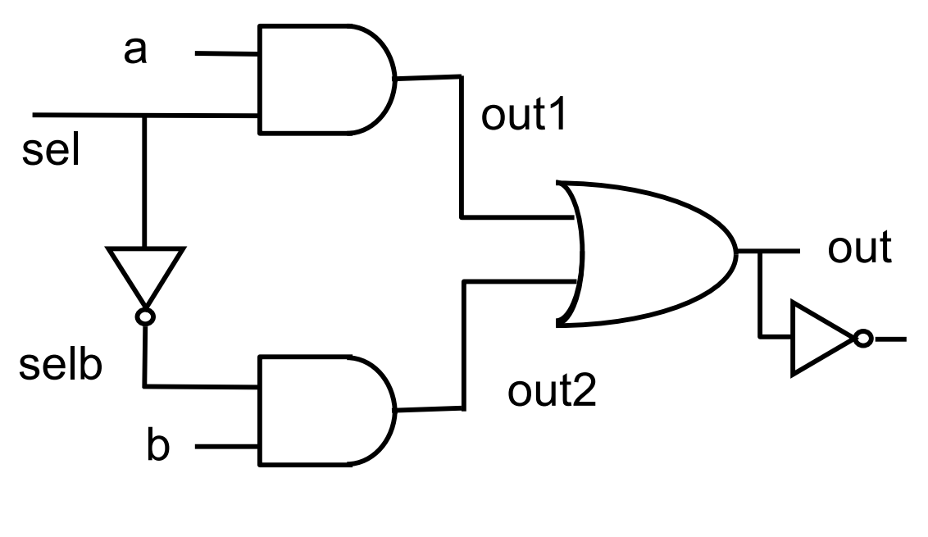
Reminder: Mux Implementation
module mux (
output logic out,
output logic outn,
input logic [1:0] in,
input logic sel
);
logic out1, out2, selb;
and a1 (out1, in[0], sel);
not i1 (selb, sel);
and a2 (out2, in[1] , selb);
always_comb begin
out = out1 | out2;
end
assign outn = ~out;
endmodule
in
In[0]
2
In[1]
outn

Slide 16
The if Statement - Example
Mux Module:
module mux (
input logic A,
input logic B,
input logic sel,
output logic Q
;(
always_comb begin
if (sel == 1'b0) begin
Q = A;
end
else begin
Q = B;
end
end
endmodule
A
0
Q
B
1
sel
Notes:
בדומה לסדנה הקודמת יצרנו כאן מוקס, רק שהפעם הקוד הרבה יותר קצר, ברור והמיפוי בקצה הוא אותו המיפוי

Slide 17
Conditional Statements: The case Statement
Used in procedural blocks
Syntax:
case (<signal/expression>)
<value1>: begin
<statement1>;
end
<value2>: begin
<statement2>;
<statement3>;
end
default: begin
<statement4>;
end
endcase

Slide 18

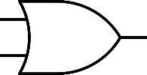
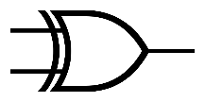
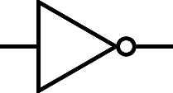
The case Statement - Example
module case_example (
input logic A,
input logic B,
input logic [1:0] w,
output logic Y
;(
always_comb begin
case (w)
2'b00: Y = A & B;
2'b01: Y = A | B;
2'b10: Y = A ^ B;
default: Y = ~B;
endcase
end
endmodule
A
B
00
01
Y
10
11
2
w

Slide 19
Conditional Statements: casex, casez
Variants of case Statements:
casex and casez
casez – ? and z are considered as don’t cares [0,1,z]
casex – ?, x and z are considered as don’t cares [0,1,x,z]
Example:
casez(w)
2'b1?: A = B + C;
2'b01: A = B ^ C;
default: A = B – C;
endcase
When using casez or casex we will use ? As don’t cares of 0/1
Notes:
למה חשוב ערך דיפולטי?

Slide 20
A Not-To-Do Example
module bad_mux (
input logic A,
input logic B,
input logic sel,
output logic Q
;(
always_comb begin
if (sel == 1'b1) begin
Q = A;
end
end
endmodule
A
Latch
I
O
Q
sel
G
Notes:
מאחר ולא כיסינו את כלל האפשרויות יווצר לנו לאצ' אשר ישמור את הערך הקודם של קיו מאחר והערך של קיו לא משתנה ולא מוזן מהכניסות.
צריך לשמור את הערך הקודם ולכן יווצר רכיב זכרון

Slide 21
Complete Assignments
always_comb should NOT be used for memory elements!
If a signal is not assigned in a certain flow, a memory element is implicitly created to preserve the previous value
Usually, this is a bug!
When using always_comb, always use complete assignments, i.e., assign values to all signals in all logic flows!

Slide 22
Complete Assignments: Guidelines
“if” statements
Use “else”
“case” statements
Use “default”
General solution
Use default assignments
Otherwise there might be uncovered options which lead to a bug.
always_comb begin
Q = 1'b0;
if (sel == 1'b1) begin
Q = A;
end
end
‘0’
0
Q
A
1
sel
Notes:
באג במג'יק של הוק ריבר

Slide 23
Agenda
More operators
Conditional statements
Synchronous logic and assignments
Test benches for synchronous logic

Slide 24
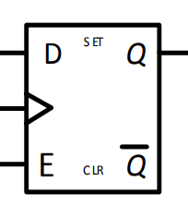
Flip Flop: Reminder
Notes:
סט – להכיל ערך של 1 בפליפלופ בתחילת עולם
כליר – להתחיל ערך של 0

Slide 25

The always_ff Statement
always_comb: implements an asynchronous/ combinatorical block
always_ff: implements a synchronous block
clk

Slide 26
The always_ff Statement (without Reset)
Syntax:
always_ff @(posedge clk) begin
<sync statement1>;
<sync statement2>;
end
Sync Statements (on clock rise)
Sensitivity List
Notes:
רשימת רגישויות – מתי להריץ את אבן היסוד

Slide 27
always_ff Example: Implementing a Flip-Flop
logic a, in;
always_ff @(posedge clk) begin
a <= in;
end
‘0’
in
a
clk
‘1’
‘0’

Slide 28
The always_ff Statement with Reset
Syntax:
Sensitivity List (no reset!)
With Asynchronous Reset:
With Synchronous Reset:
always_ff @(posedge clk, posedge rst) begin
if (rst == 1'b1) begin
<reset statement1>;
end
else begin
<sync statement2>;
end
end
always_ff @(posedge clk) begin
if (rst == 1'b1) begin
<reset statement1>;
end
else begin
<sync statement2>;
end
end
Sensitivity List
Initialization Statements (on reset)
Sync Statements (on clock rise)
Initialization Statements (on reset)
Sync Statements (on clock rise)
Notes:
ריסט אסינכרוני – תגובה מיידית
הפסקה

Slide 29
always_ff Example: Implementing a Flip-Flop with Reset
logic a, in;
always_ff @(posedge clk, posedge rst) begin
if (rst == 1'b1) begin
a <= 1'b0;
end
else begin
a <= in;
end
end
‘0’
in
a
clk
‘1’
rst

Slide 30
Assignment in an always_ff Block
In always_comb, we use a blocking assignment (= operator):
In always_ff, we use a non-blocking assignment (<= operator):
logic a, in;
always_comb begin
a = in;
end
logic a, in;
always_ff @(posedge clk) begin
a <= in;
end

Slide 31
Procedural Assignments
Occur within procedural blocks such as always_comb, always_ff and initial
Triggered when the flow of execution reaches them
Blocking/Non-blocking
Blocking assignment statement (= operator) acts much like in traditional programming languages. The whole statement is done before control passes on to the next statement
Non-blocking assignment statement (<= operator) evaluates all the right-hand sides for the current time unit and assigns the left-hand sides at the end of the procedural block
Notes:
מתי נבחר בלוקינג אל מול נון בלוקינג
כשנרצה השמה מיידית – בלוקינג
כשנרצה השמה בסיום המערכת – נון בלוקינג

Slide 32
Example – Non blocking
module shifter(
input logic in,
input logic clk
;(
logic A, B, C;
always_ff @(posedge clk) begin
A <= in;
B <= A;
C <= B;
end
endmodule
in
A
B
C
clk
Notes:
טבלת אמת
In = 0, A =1, B = 1, C = 1

Slide 33
Example – Blocking
module bad_shifter(
input logic in,
input logic clk
;(
logic A, B, C;
always_ff @(posedge clk) begin
A = in;
B = A;
C = B;
end
endmodule
in
A
B
C
clk

Slide 34

Assignment Summary
Synchronous logic: Use non-blocking statements with always_ff blocks sensitive only to rising clock edge to mimic parallel synchronous logic.
Combinational logic: Use blocking statements inside always_comb blocks with to mimic logic flow of combinational logic.

Slide 35
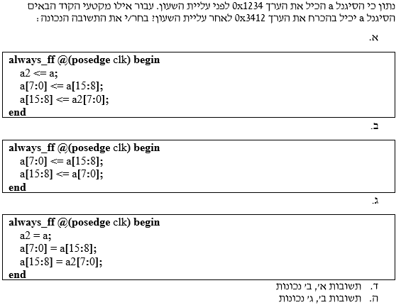
Assignment: A Question From an Exam (Winter '18-'19)
Notes:
מה זה 0x?
תשובה ה

Slide 36
Example: Synchronous and Asynchronous Logic
Asynchronous/Combinatorical Logic
and_out
or_out
A
A
A
rst
B
B
clk
Synchronous Logic

Slide 37
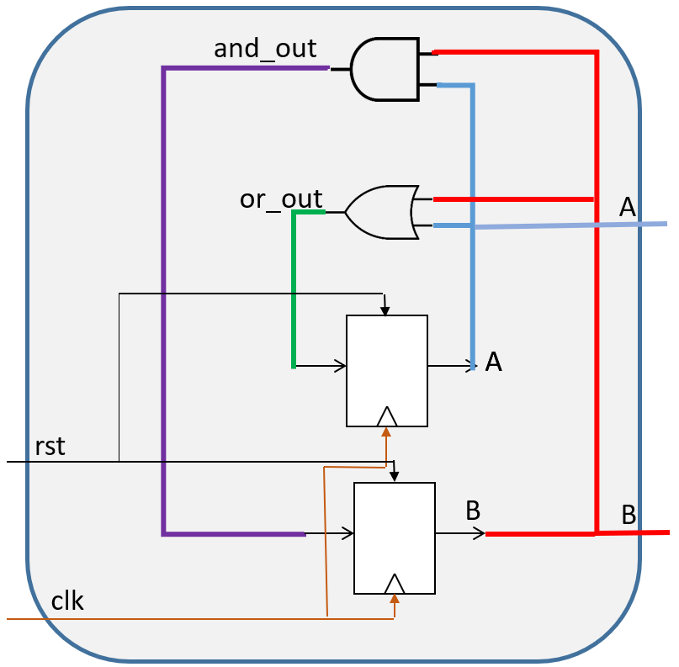
Example: Sync. and Async. Logic
module my_module (
input logic clk,
input logic rst,
output logic A,
output logic B
;(
logic and_out, or_out;
always_ff @(posedge clk, posedge rst) begin
if (rst == 1'b1) begin
A <= 1'b0;
B <= 1'b1;
end
else begin
A <= or_out;
B <= and_out;
end
end
always_comb begin
and_out = A & B;
or_out = A | B;
end
endmodule
Asynchronous/Combinatorical Logic
Synchronous Logic
Notes:
מה ניתן לשנות בקוד כדי להשתמש רק בבלוק סינכרוני

Slide 38
Example: Sync. and Async. Logic: Another Implementation
module my_module (
input logic clk,
input logic rst,
output logic A,
output logic B
;(
always_ff @(posedge clk, posedge rst) begin
if (rst == 1'b1) begin
A <= 1'b0;
B <= 1'b1;
end
else begin
A <= A | B;
B <= A & B;
end
end
endmodule
Asynchronous &
Synchronous Logic

Slide 39
Example: Sync. and Async. Logic: Synthesis error
module my_module (
input logic clk,
input logic rst,
input logic C,
output logic A,
output logic B
;(
logic d;
always_ff @(posedge clk, posedge rst) begin
if (rst == 1'b1) begin
A <= 1'b0;
B <= 1'b1;
end
else begin
A <= A | d;
B <= A & B;
end
if (C == 1) begin
d <= 1'b1;
end
end
endmodule
Notes:
מה הבעיות שיווצרו בקטע הקוד הנל?
אנחנו עלולים להשתמש בd לפני שהוא אותחל אין else statement לd מה שיגרום לכך שישנם מסלולים אשר d אינו מאותחל בהם ואין לו ערך דיפולטי במצב של reset.
הסיתנזה עלולה לחשוב שd משמר את הערך שלו מה שיגרום ליצירת ff נוספים ופגיעה בביצועים בגלל דיליי

Slide 40
Example: Sync. and Async. Logic: Synthesis error
There are 3 types of synthesis issues that may arise in this design:
“Variable d used before assigned” :
This occurs because d is used in A <= A | d; before being guaranteed an initial value when C == 0.
“Variable d is not fully assigned in all paths”.
The assignment to d only happens conditionally (if(c)) with no else clause or reset.
“Synthesis assumes d retains its value”
When d is not updated in a cycle, tools assume it holds its previous value via a flip-flop.
While technically legal, this can result in:
Unintended stateful behavior.
Incorrect logic if the user expected a purely combinational update.
Performance delay.

Slide 41
Agenda
More operators
Conditional statements
Synchronous logic and assignments
Test benches for synchronous logic

Slide 42
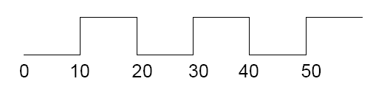
Test Bench: Generating a Clock Signal
initial begin
Clock = 1'b0;
end
...
always begin
#10 Clock = ~Clock;
end
always statement: runs in an endless loop
Clock
Notes:
מה זמן המחזור של השעון במקרה הזה?

Slide 43
Test Bench: The Repeat Loop
Used in an initial block to repeat statements.
Syntax:
Example: Waiting for 4 clock cycles
repeat(num_of_times) begin
<statement1>;
<statement2>;
end
initial begin
repeat(4) begin
@(posedge clk);
end
end

Slide 44
Example: Sync. and Async. Logic: Another Implementation
module my_module (
input logic clk,
input logic rst,
output logic A,
output logic B
;(
always_ff @(posedge clk, posedge rst) begin
if (rst == 1'b1) begin
A <= 1'b0;
B <= 1'b1;
end
else begin
A <= A | B;
B <= A & B;
end
end
endmodule
Asynchronous &
Synchronous Logic

Slide 45
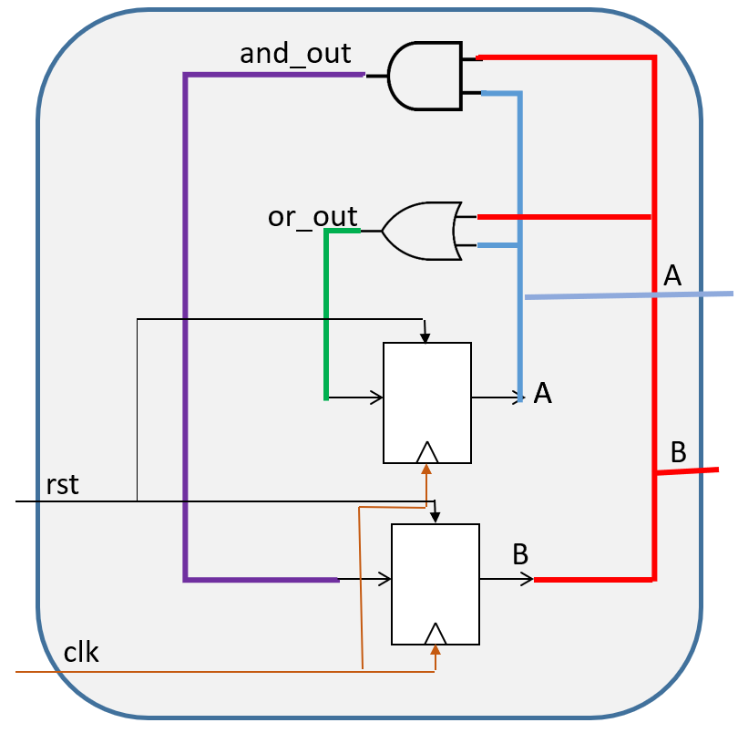
Test Bench: Full Example
module my_module_tb;
logic clk, rst;
logic A, B;
my_module inst(.clk(clk), .rst(rst), .A(A), .B(B));
always begin
#10 clk = ~clk;
end
initial begin
clk = 1'b0;
rst = 1'b1;
@(posedge clk);
7#
rst = 1'b0;
repeat(2) begin
@(posedge clk);
end
end
endmodule

Slide 46
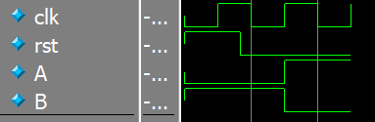
Test Bench: Full Example
Notes:
הבהרה מאוד מאוד מאוד חשובה על סנכרון בין סיגנלים לשעון! לדוגמה, לא יקרה מצב בו סיגנל ריסט עולה בירידת שעון

Slide 47
Another Example: Simple Counter
+1
next_counter
current_counter
clk

Slide 48
Another Example: Simple Counter
logic [3:0] current_counter;
always_ff @(posedge clk, posedge rst) begin
if (rst == 1'b1) begin
current_counter <= 4'b0;
end
else begin
current_counter <= next_counter;
end
end
always_comb begin
next_counter = current_counter + 1;
end
+1
next_counter
current_counter
clk
Notes:
מה יקרה אחרי 16 מחזורי שעון לקאונטר? למה הוא יהיה שווה?

Slide 49
Another Example: Simple Counter
logic [3:0] current_counter;
always_ff @(posedge clk, posedge rst) begin
if (rst == 1'b1) begin
current_counter <= 4'b0;
end
else begin
current_counter <= current_counter + 1;
end
end
+1
current_counter
clk

Slide 50
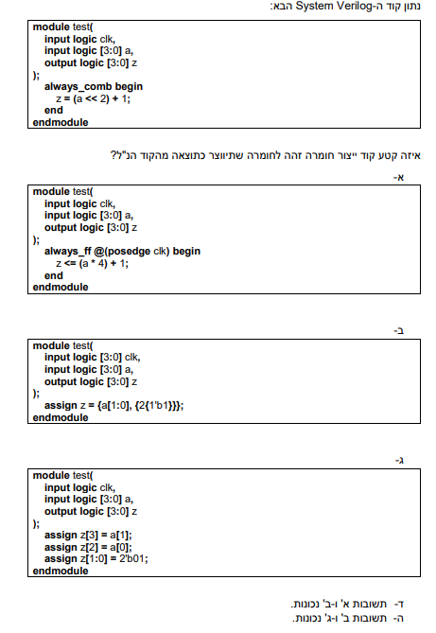
A Question From an Exam (Spring '19)

Slide 51
Notes:
תשובה ג

Slide 52
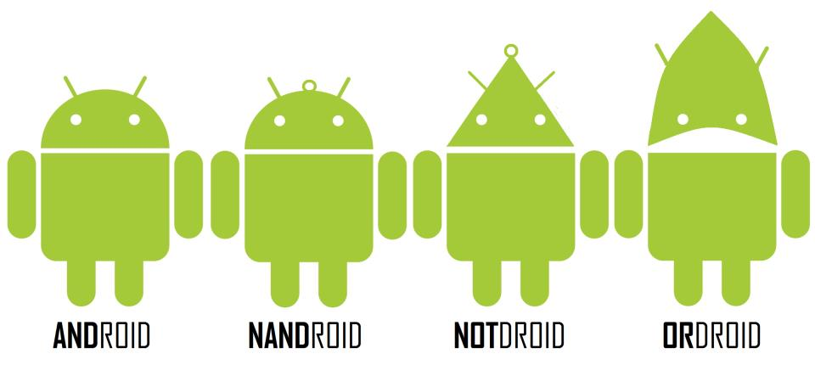
Questions?

Slide 53
Workshop #3 Cheat Sheet
Logical operators: &&, ||, !
Relational operators: >, >=, <, <=, ==, !=
if statement:
if (condition1) begin
<statement1>;
end
else if (condition2) begin
<statement2>;
end
else begin
<statement3>;
<statement4>;
end

Slide 54
Workshop #3 Cheat Sheet
case statement:
casez: ? and z are considered as don’t cares [0,1,z]
casex: ?, z and x are considered as don’t cares [0,1,z,x]
case (<signal/expression>)
<value1>: begin
<statement1>;
end
<value2>: begin
<statement2>;
<statement3>;
end
default: begin
<statement4>;
end
endcase

Slide 55
Workshop #3 Cheat Sheet
always_ff statement:
always_ff with reset:
Async. Reset: Sync. Reset:
always_ff @(posedge clk) begin
<sync statement1>;
<sync statement2>;
end
always_ff @(posedge clk, posedge rst) begin
if (rst == 1'b1) begin
<reset statement1>;
end
else begin
<sync statement2>;
end
end
always_ff @(posedge clk) begin
if (rst == 1'b1) begin
<reset statement1>;
end
else begin
<sync statement2>;
end
end

Slide 56
Workshop #3 Cheat Sheet
Generating a clock signal:
repeat loop:
initial begin
Clock = 0;
end
...
always begin
#10 Clock = ~Clock;
end
repeat(num_of_times) begin
<statement1>;
<statement2>;
end

